Slide 1
Concorde NC Land Development
Student’s Name
Institutional Affiliation’s

Slide 2
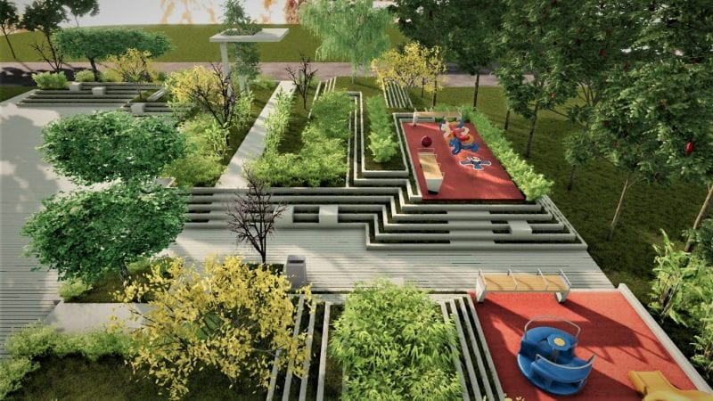
Land Development
Site Overview
-Situated to the west of Concord-Padgett regional airport new commercial service terminal building
-Used as dumping site for years until 2 years ago
-Extensive piece of flatland (4.3mPD to 5.8mPD)
Soil and Geotechnical conservation
-Comprises of two rock compositions
-One side, strong pinkish brown soil
Slightly decomposed rocks
On the other side, faintly decomposed quartzite rock
Notes:
The project area is situated to the west of Concord-Padgett regional airport and new commercial service terminal building in the Northwest. The area is comprised of extensive piece of flatland at an elevation of 4.3mPD to 5.8MPD. Old river courses of Clarke Creek River also surround the site. Based on the Ariel view of the area, it was previously used as waste dumping until two years ago when a private company acquired it through the state governmen. First, the solid geology, which comprises of moderately strong pinkish brown and slightly, decomposed granite at the Southeast of the area.

Slide 3
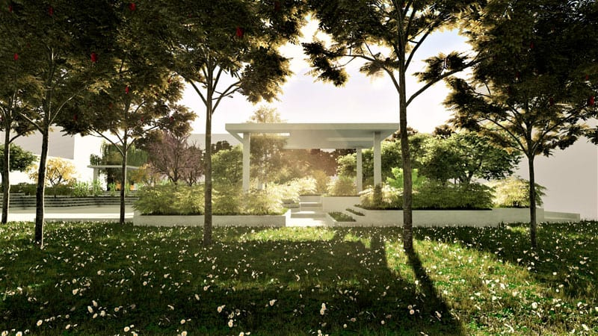
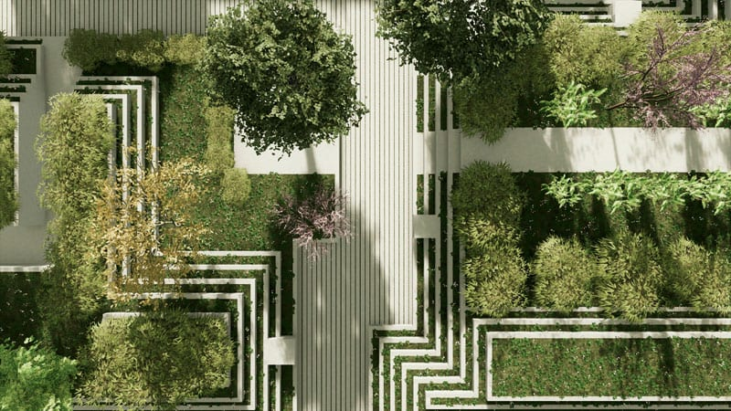
Continuation of Land Development
Project Phases
Preliminary- provides context
Design phase- identifying hypotheses
Technical analysis phase- choosing alternative
Open Space
-Urban open space to be adopted
This system will help resolve
changing challenges
It cost effective and practical
Notes:
The project is supposed to take three faces; preliminary phase, design phase, and technical analysis phase. Preliminary phase provides the context and territorial planning of the project. Design phase follows the preliminary phase which involves identifying various hypotheses to help determine the most suitable arrangement. Technical analysis phase is the last phase which involves determining the best alternative to use. This project will adopt the urban open space concept. Due to its ability to touch on different city-life elements, the urban open space planning is not only cost effective, but also practical.

